Slide 1
Docker session
A guide to dockerland

Slide 2
Agenda
What is docker and why we need it.
Container Technology.
Container vs. VM.
Why Containers.
Docker Basics:
Images
Containers
Volumes
Networks
Docker Files.
Multiple Containers.
Docker Compose.

Slide 3
What is docker
Docker is a container technology: A tool for creating and managing containers.
OH, ok , what is container ?!
Container is A standardized unit of Software A package of code and dependencies to run that code (e.g. NodeJS code + the NodeJS runtime)

Slide 4
Why docker
The same container always yields the exact same application and execution behavior! No matter where or by whom it might be executed.
Support for Containers is built into modern operating systems!
Docker simplifies the creation and management of such containers.

Slide 5
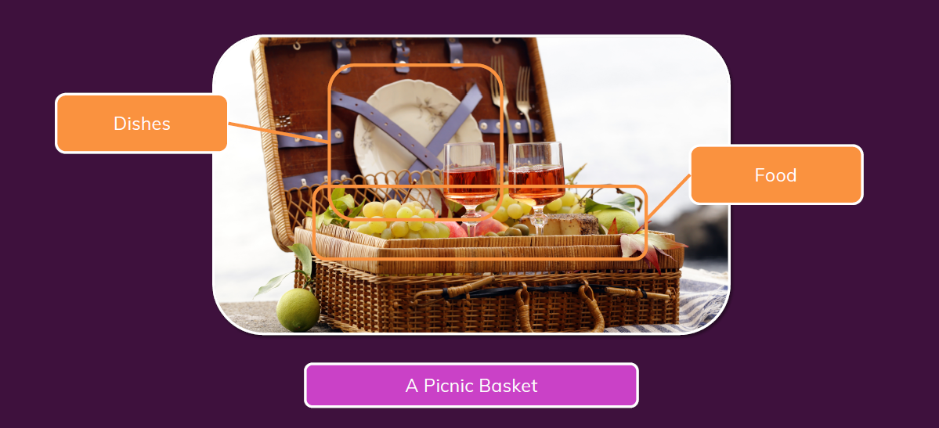
Real life example (panic basket)

Slide 6
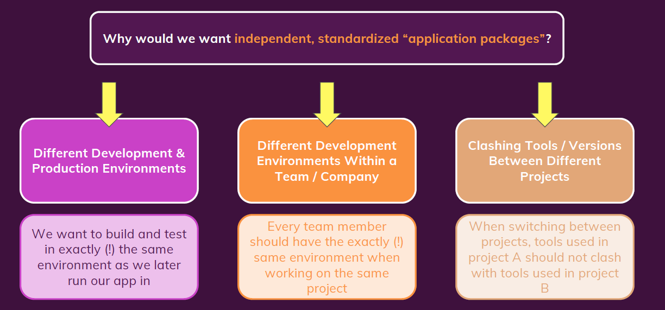
Why containers

Slide 7
Problem caused by different environments
Firstly, what is environment ??
Environment: The runtimes, languages, frameworks you need for development.

Slide 8
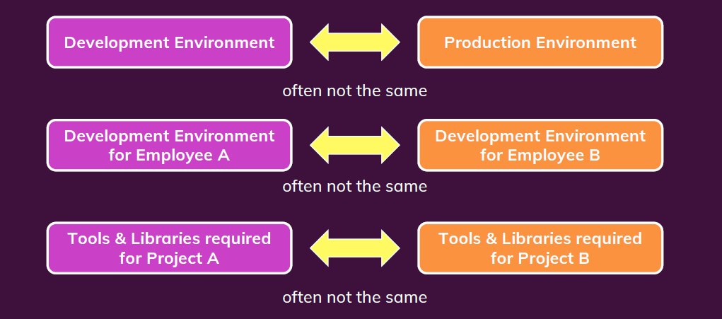
Dev vs. prod env

Slide 9
Conclusion
We want to have the exact same environment for development and production è This ensures that it works exactly as tested.
It should be easy to share a common development environment/ setup with (new)employees and colleagues.
We don’t want to uninstall and re-install local dependencies and runtimes all the time.

Slide 10
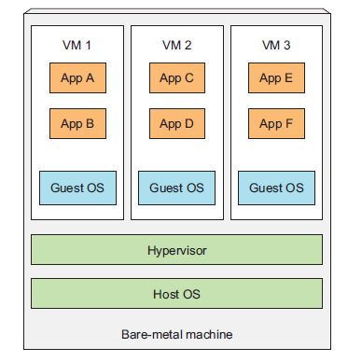
Virtual machines
When you run three VMs on a host, you have three completely
separate operating systems running on and sharing the same
bare-metal hardware.
Wastes a lot of space on your hard drive and tends to be slow.

Slide 11
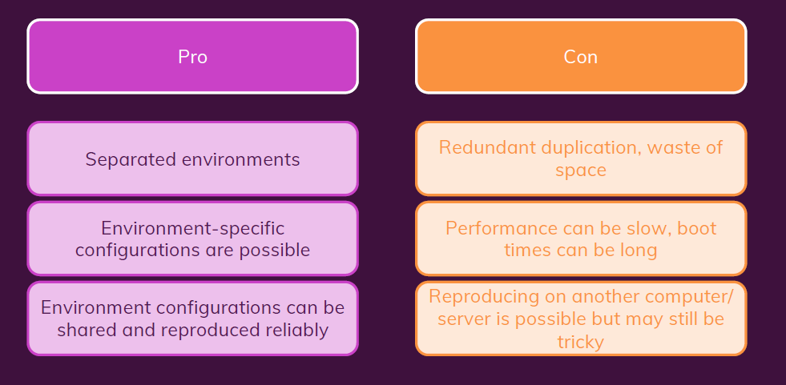
Virtual Machines / Virtual OS: Summary

Slide 12
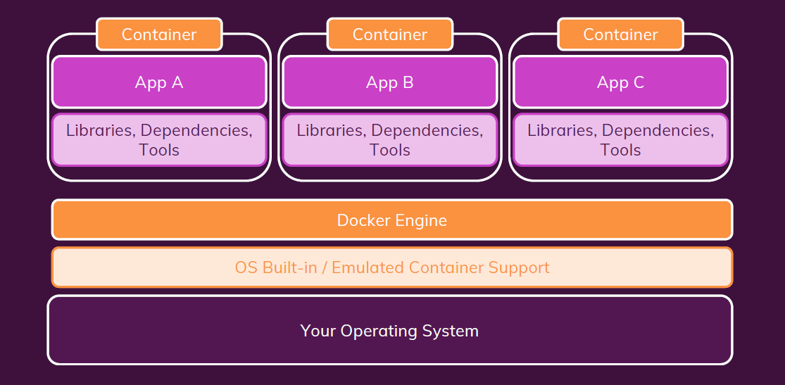
Docker system

Slide 13
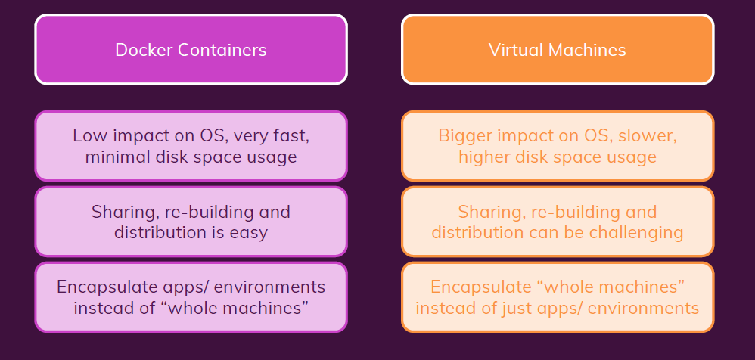
Containers vs Virtual Machines

Slide 14
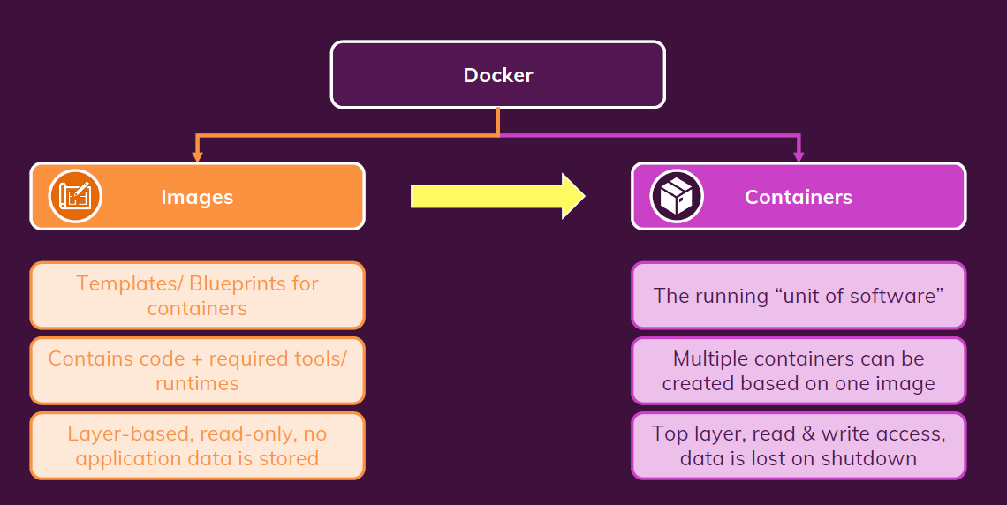
Images vs Containers

Slide 15
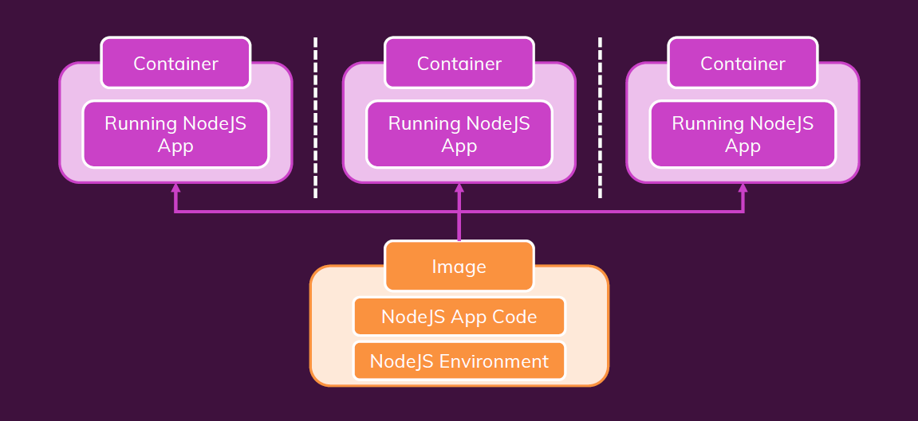
One Image, Multiple Containers

Slide 16
Finding / Creating Images
Use an existing, pre-built Image (e.g. vie Docker Hub https://hub.docker.com/)
Create your own, custom Image: Write your own Dockerfile (based on another Image). (e.g. node JS app based on node JS as base image).

Slide 17
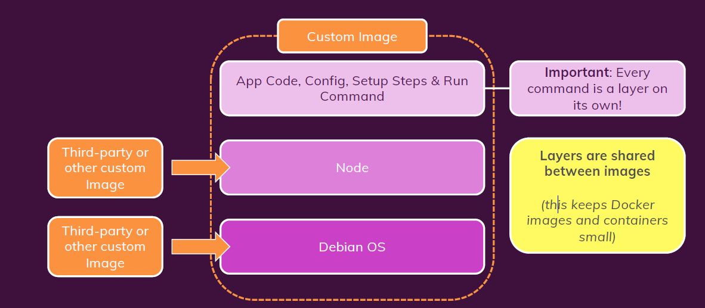
Images & Image Layers

Slide 18
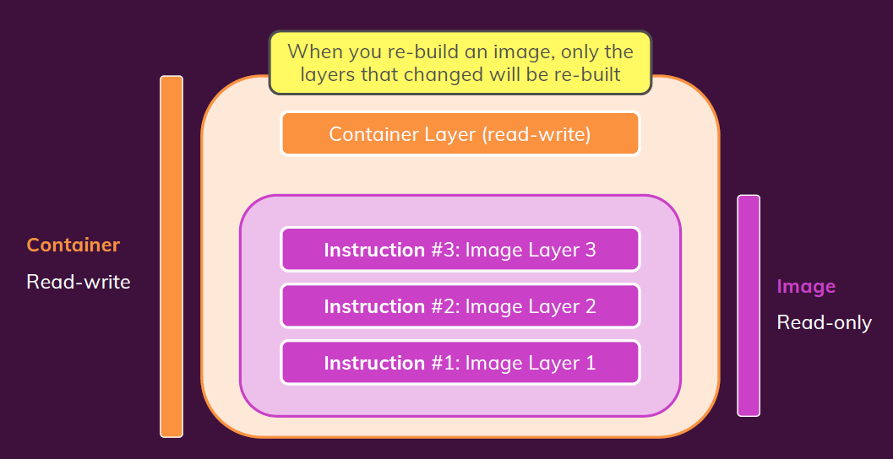
A Container Is Based On An Image
When you re-build an image, only the layers
that changed will be re-built(caching).
Multiple Containers Can Be Based On
The Same Image.

Slide 19
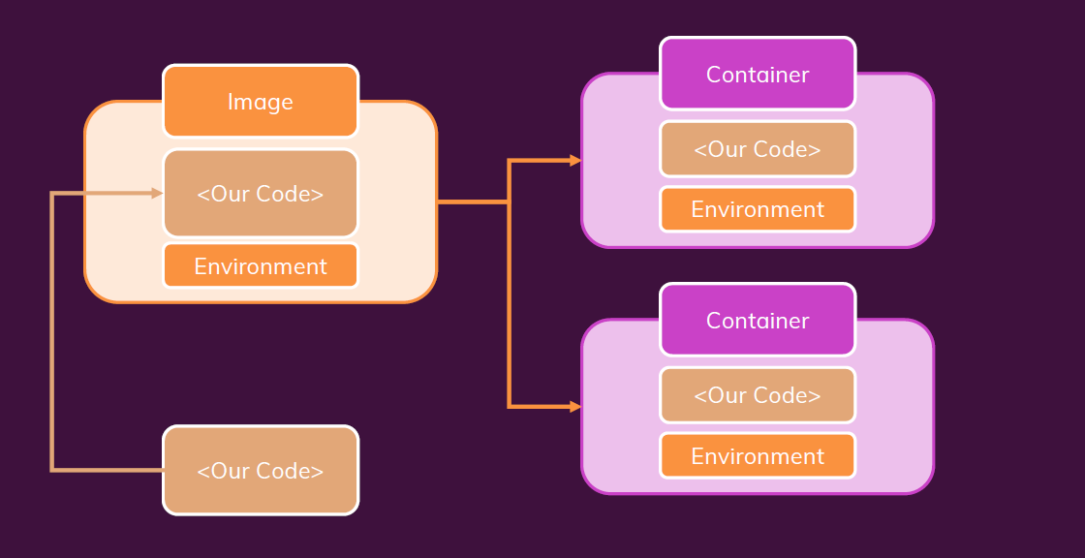
First Summary

Slide 20
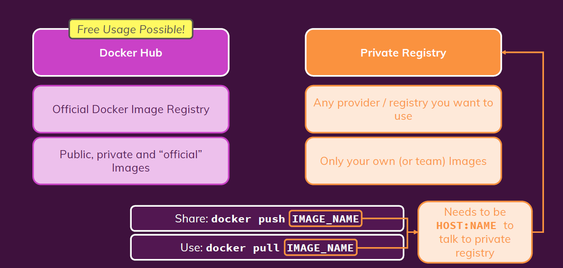
Registries
It’s repository that used to push images to it and
pull them to use that images again in another projects.
Popular registries :
Docker Hub.
Azure Container Registry.
Amazon Elastic Container Registry (ECR).

Slide 21
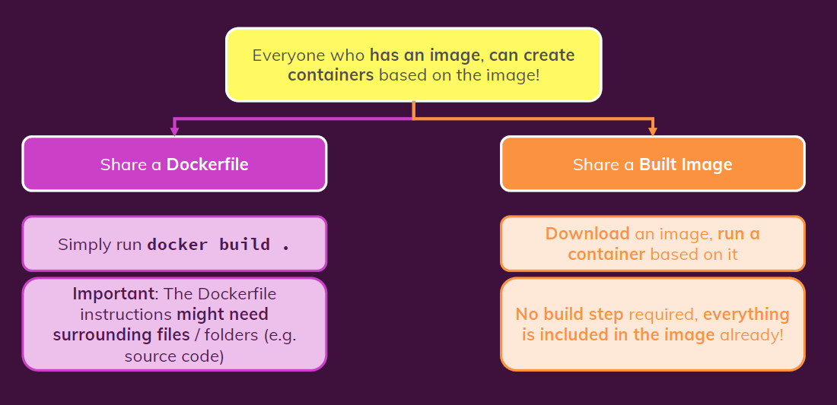
Sharing Images & Containers

Slide 22
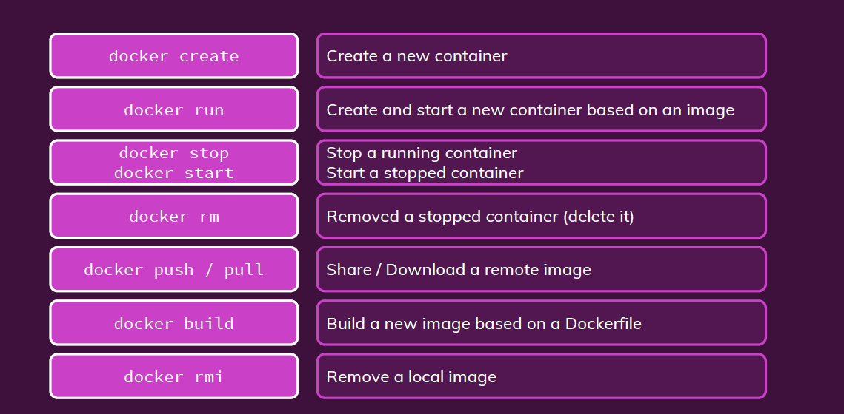
Key Commands

Slide 23
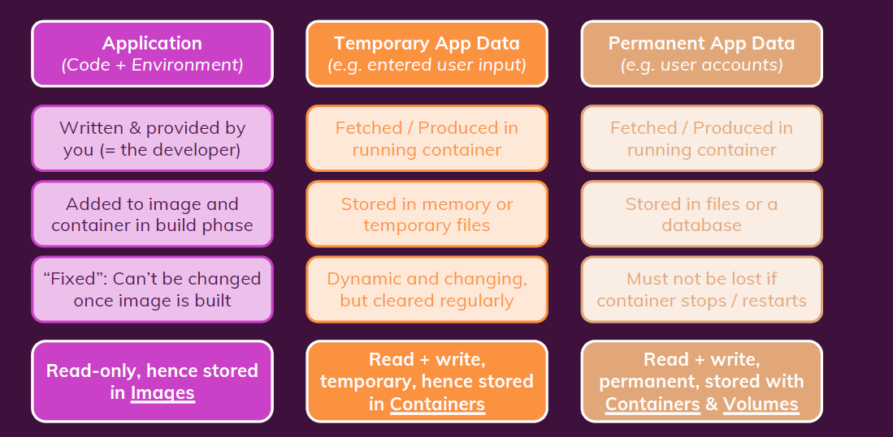
Data types

Slide 24
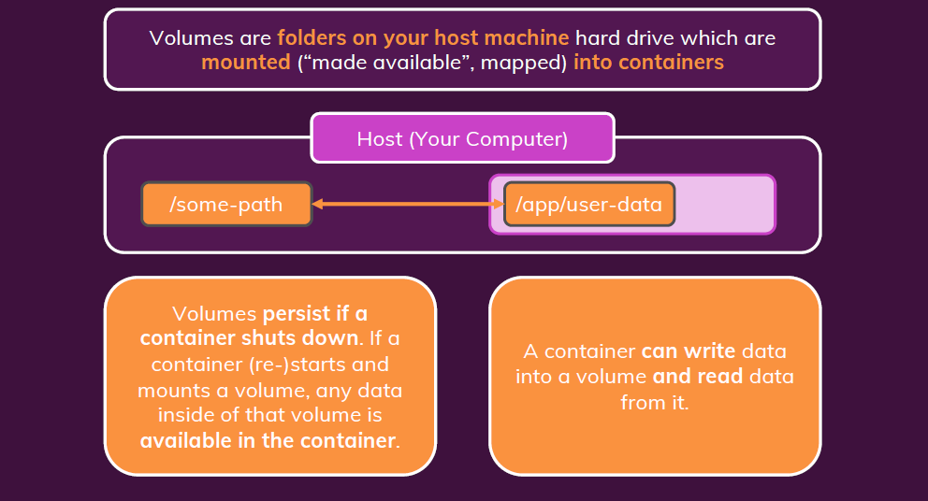
Volumes

Slide 25
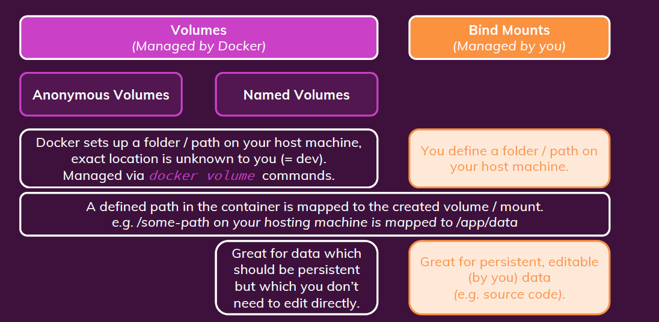
Types of volumes

Slide 26
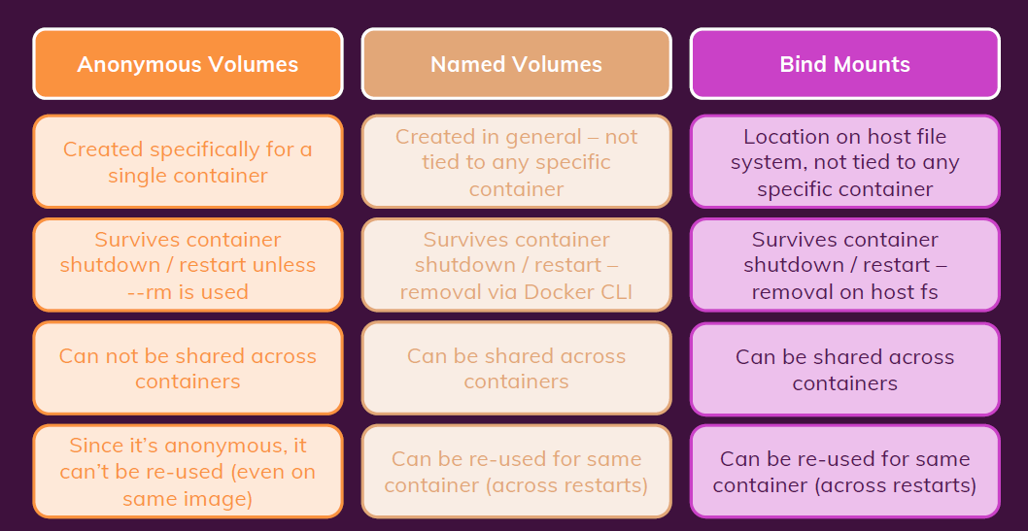
Types of volumes

Slide 27
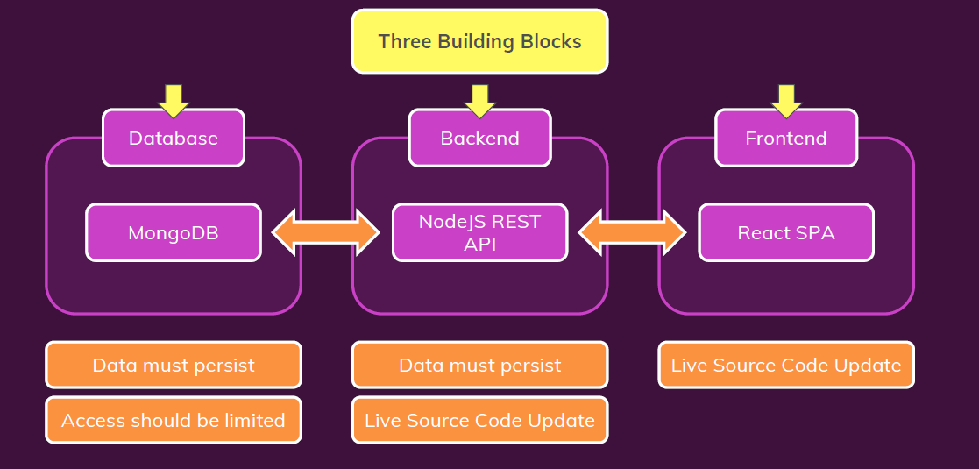
Multiple containers

Slide 28
Resources
Maximilian Schwarzmüller’s Udemy course: Docker & Kubernetes: The Practical Guide.
Kubernetes in Action a book by Marko Luksa.

